Slide 1
Group3 – Covent-dong
By: Jack Beale, Charlie Parker, Beowulf Horn, Tom, Jerry

Slide 2
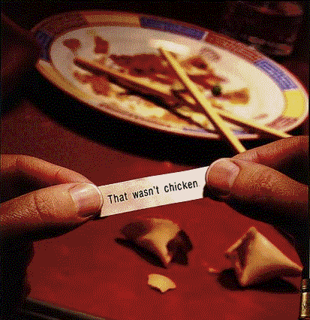
Problems when travelling abroad

Slide 3
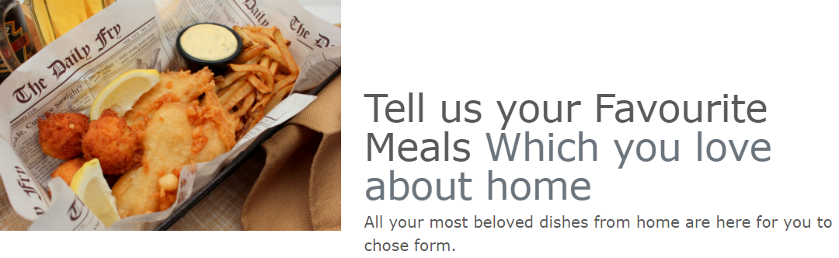
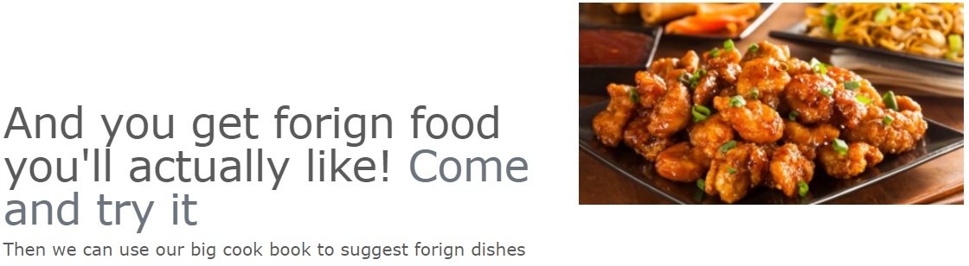
The Idea

Slide 4

The Solution

Slide 5

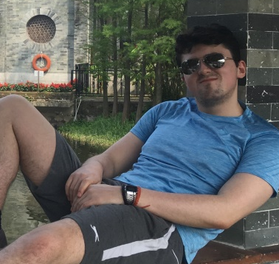
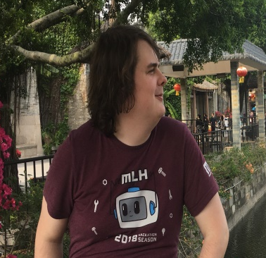
How we assigned Roles
The Front End
The Man In the Middle
ML Backend

Slide 6

What Jack has done
Website Home Page Design & Design concept

Slide 7

What Charlie has done
Create the web page to display users with the recommend meal choice.

Slide 8

What Beowulf has done
Discovered valid datasets we can use recommend users with the correct foods, and data mine them to produce a valid result.

Slide 9

How we put them together

Slide 10


Data

Slide 11
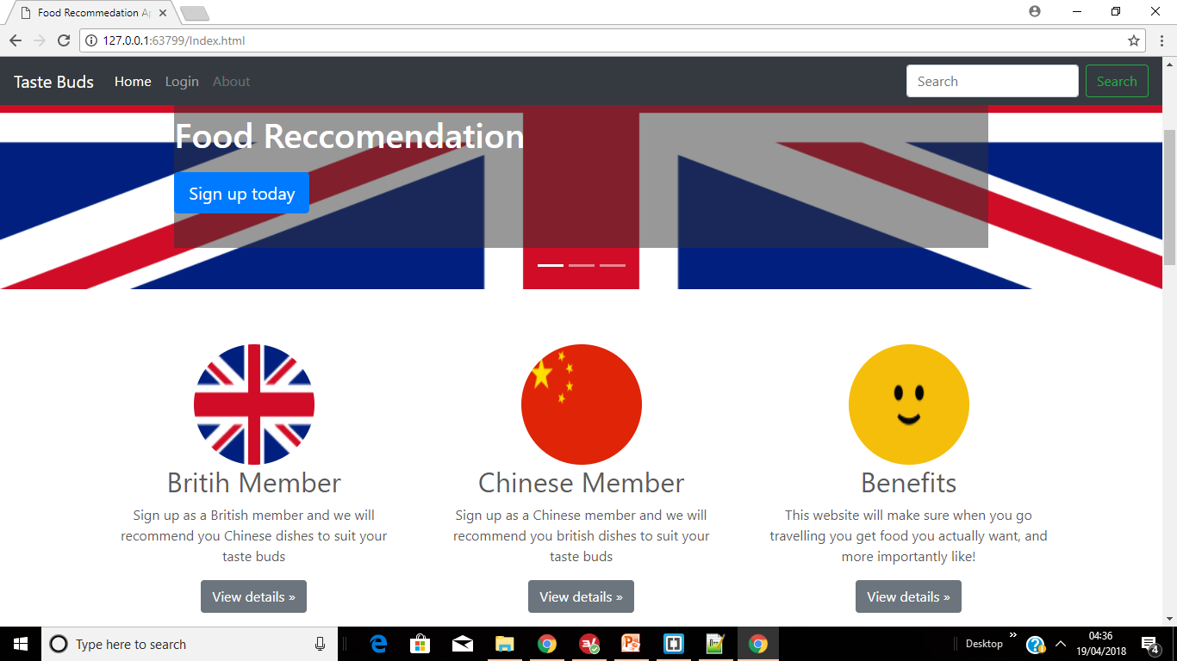
Conclusion

Slide 12

Questions?

